Slide 1

ALLUXIO

Slide 2
OUTLINE
What is alluxio?
Big data ecosystem before and now
Need of alluxio
Architecture of alluxio
When to use and its benefits
Features
Tiered storage
Unified namespace
Transparent naming

Slide 3
Dataflow in alluxio
Installations
Demo

Slide 4
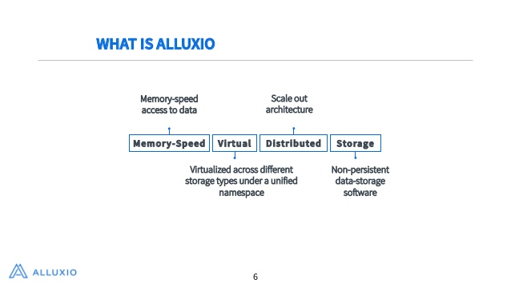

Slide 5
WHAT IS ALLUXIO?
It is open source memory speed virtual distributed storage
It is fastest growing OS project in big data ecosystem
Applications only need to connect with Alluxio to access data stored in any underlying storage systems

Slide 6
It became the de facto storage unification layer for big data and other scale
It enables virtualized data across multiple types of storage

Slide 7
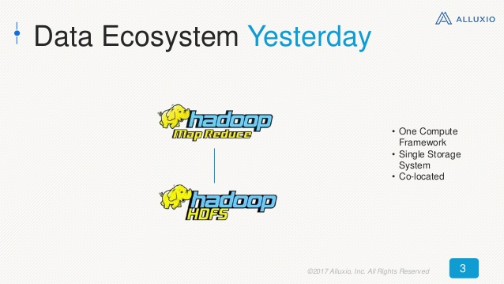

Slide 8
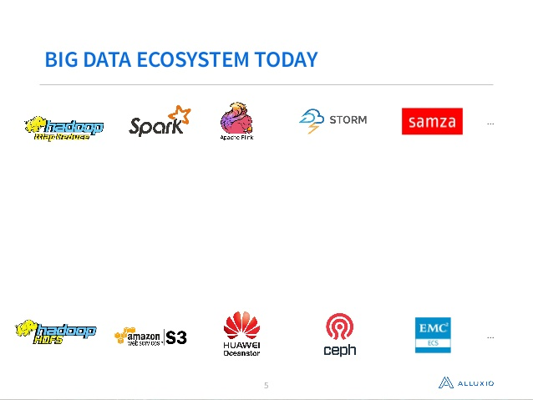

Slide 9
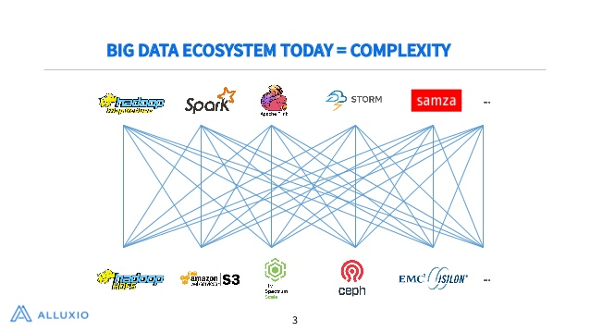

Slide 10
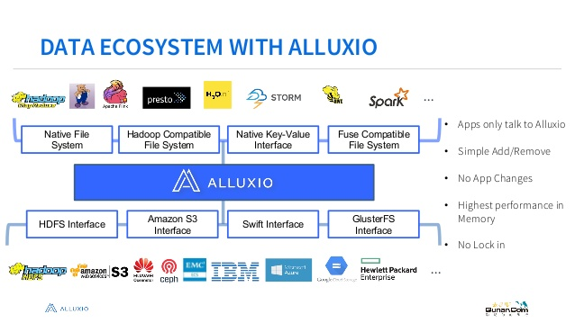

Slide 11
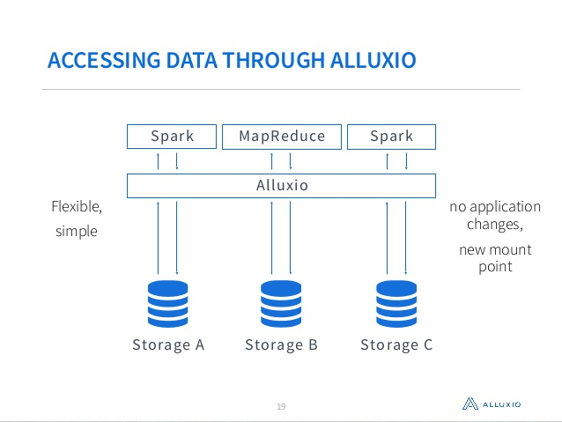

Slide 12
ORIGIN OF ALLUXIO?
Started at UC Berkeley AMPLab in 2012
Formerly known as Tachyon
CEO is Haoyan Li
First version of alluxio was built during 2012 and open sourced in 2013
2 years later alluxio was founded
It has over 250 contibutors like AliBaba, Baidu, IBM,Intel etc.

Slide 13
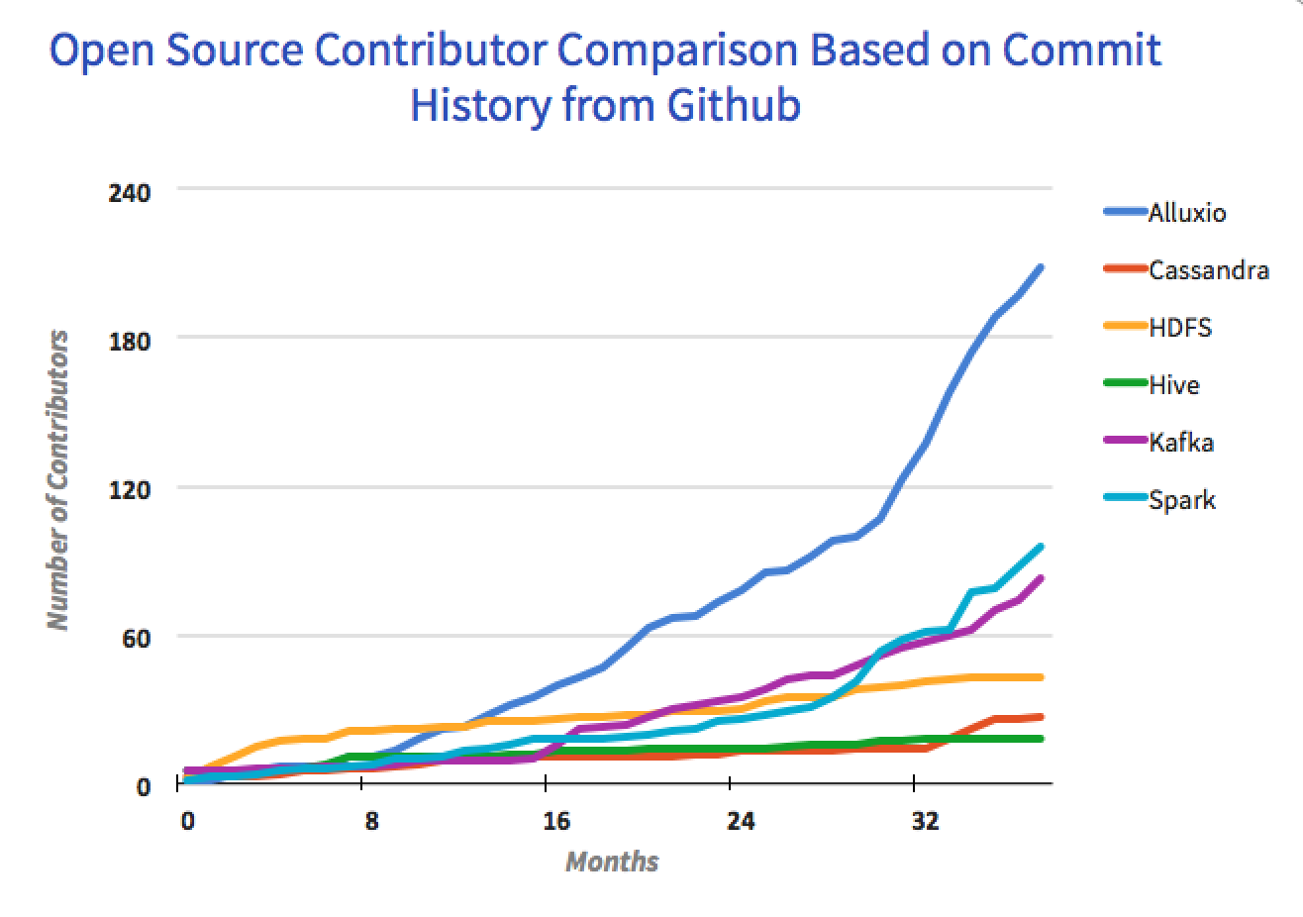
Alluxio open source contributor growth
Over 250 contributions from over 100 organizations.
3x growth over last
year.

Slide 14
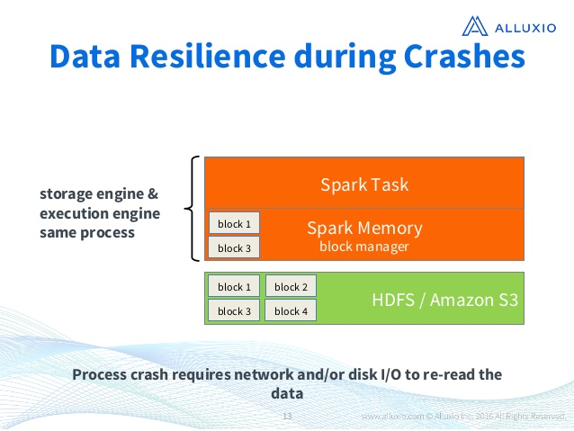
WHY TO USE ALLUXIO?
Data resiliance during application crashes

Slide 15
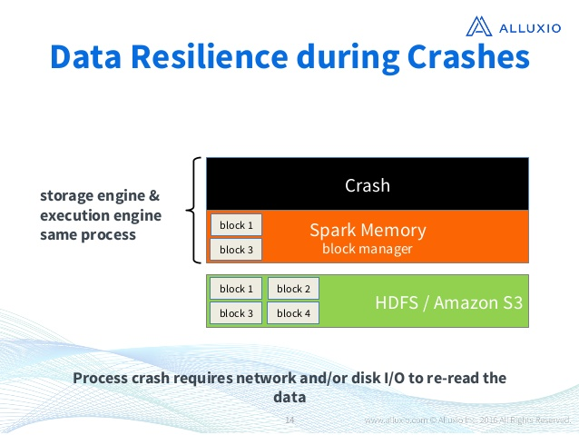

Slide 16
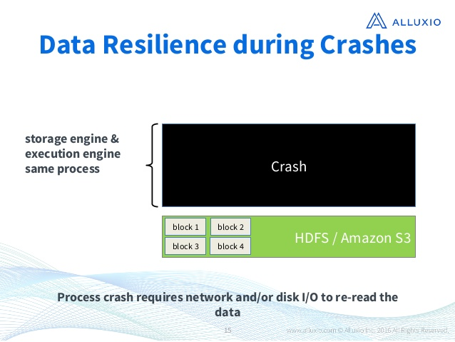

Slide 17
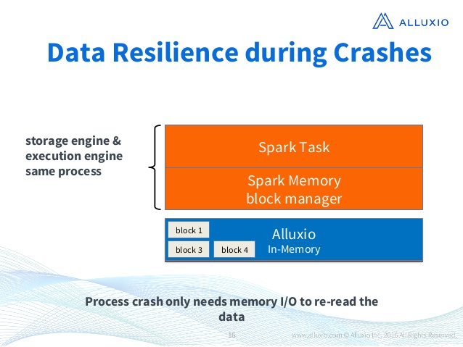

Slide 18
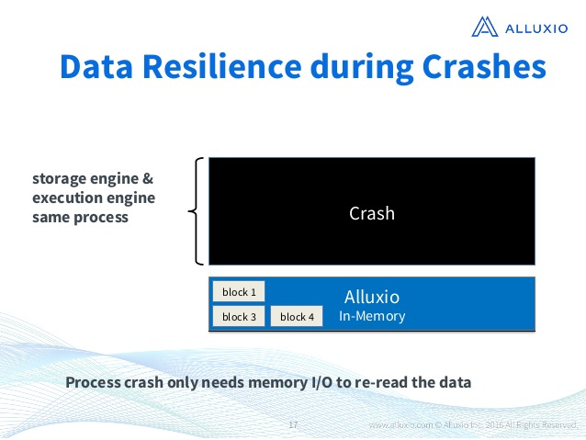

Slide 19
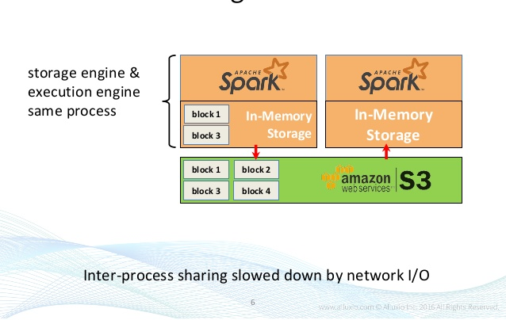
Data sharing between jobs

Slide 20
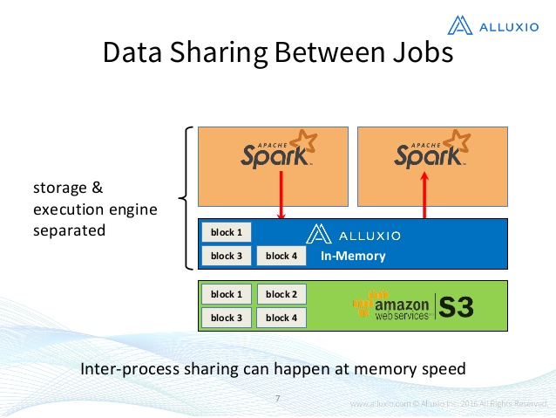

Slide 21
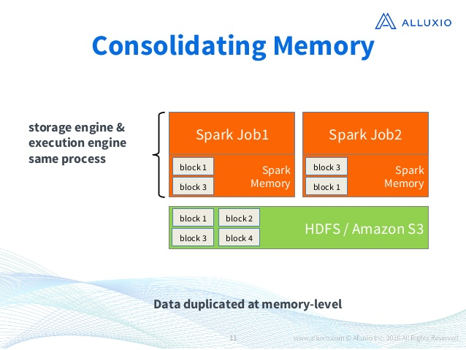
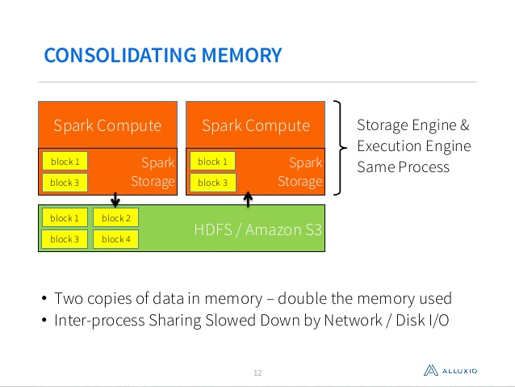
Consolidate memory usage and alleviate GC (garbage collection) issues

Slide 22
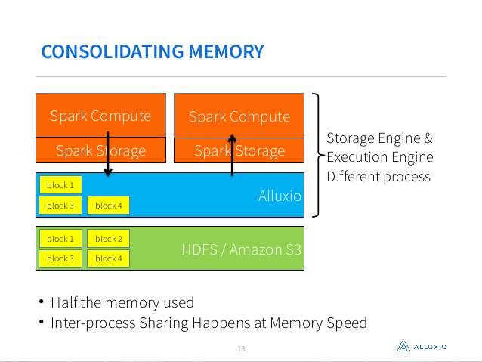

Slide 23
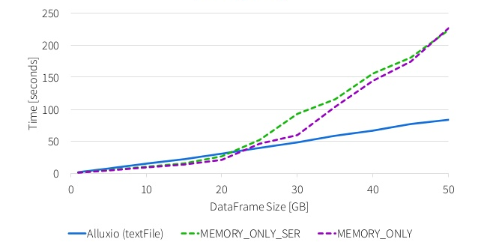
SPEED COMPARISON

Slide 24
Co-located compute and data with memory speed access to data
Distributed system,Scale out architecture
Software only ,no change needed to existing application
Virtualized across different storage systems under a unified namespace

Slide 25
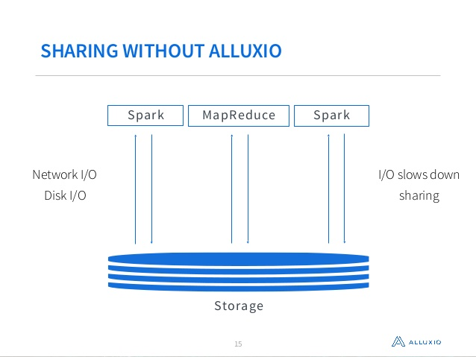
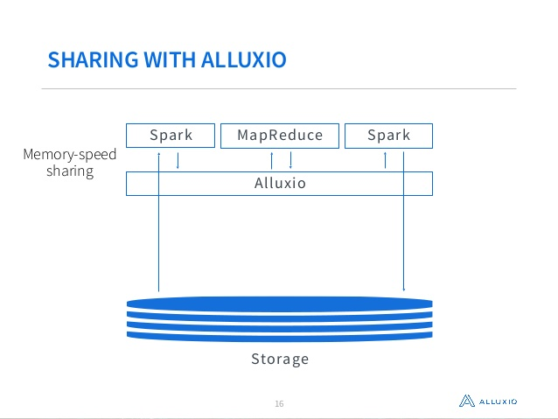

Slide 26
WHEN TO USE ALLUXIO?
When two or more jobs access the same dataset
Jobs may not always succeed
When there is large amount of data to process

Slide 27
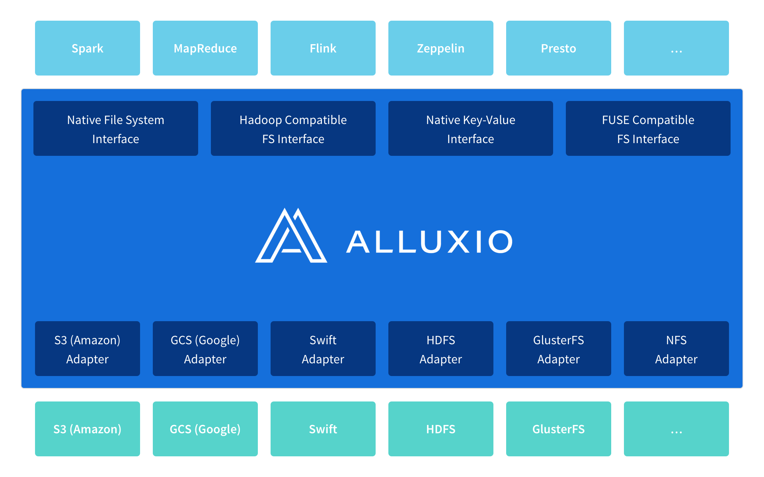
ALLUXIO ARCHITECTURE

Slide 28
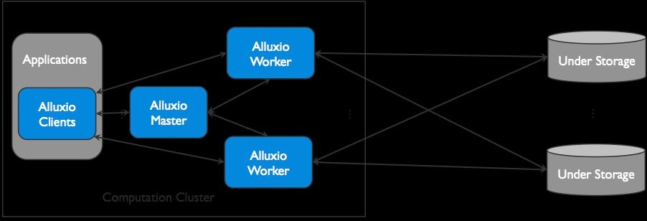

Slide 29
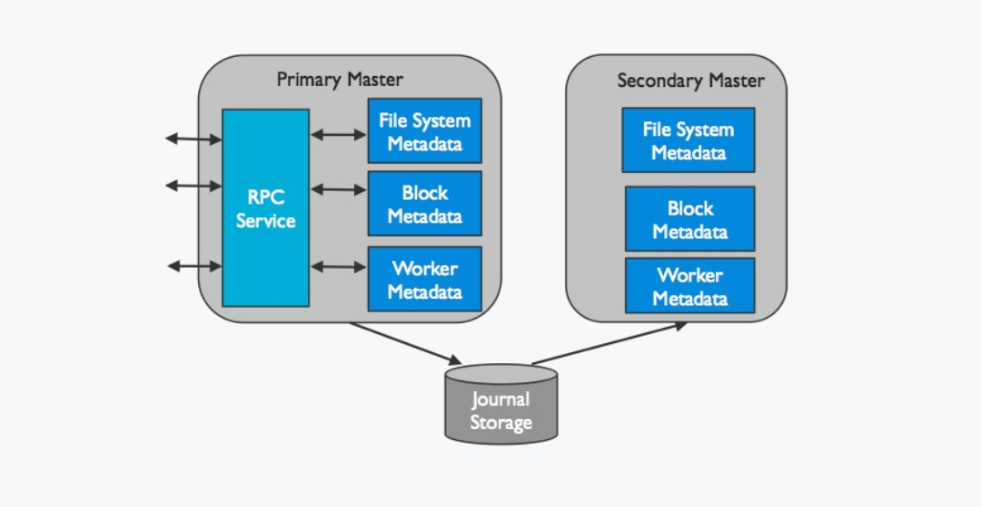
PRIMARY AND SECONDARY MASTER

Slide 30
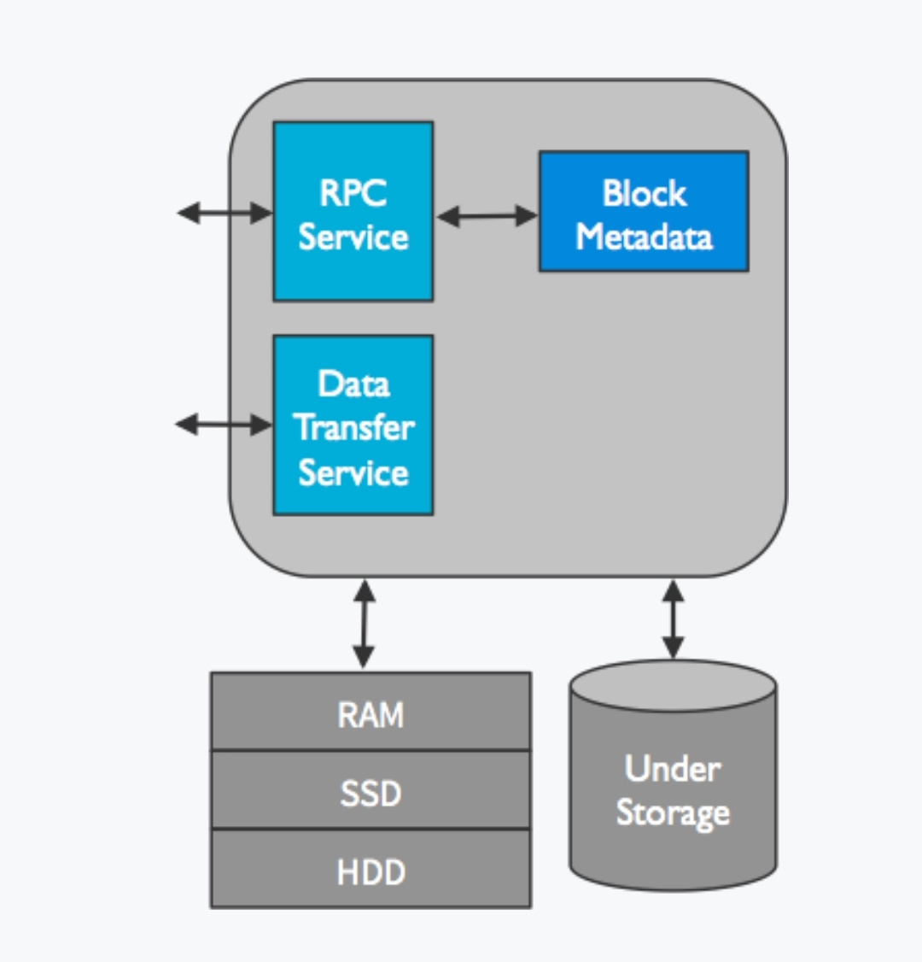
WORKERS IN ALLUXIO

Slide 31
ALLUXIO MASTER-
Maintains global metadata for system, such as file system namespace metadata ,block information metadata ,worker information metadata
ALLUXIO WORKER-
serves and manages data that clients and applications want
stores data in memory

Slide 32
reads/writes data to underlying storage systems
manages block data
UNDER FILE SYSTEM
existing storage systems that we have
we can mount different file systems to alluxio in order to provide unified namspace

Slide 33
Time configuration:
5sec → worker to master when start
10sec →worker to master 💓 beat
5min→ worker dead declare
1sec→ worker to worker 💓 beat
2min→ master to master 💓 beat
5min→ journal send
10min→ timeout primary master

Slide 34
BENEFITS OF ALLUXIO
FLEXIBILITY
enables new workloads across any storage systems
we have unified namespace which enables these applications to access data in any storage system
AGILITY
because of architecture we can work with the framework of our choice
we can work with the storage of our choice

Slide 35
PERFORMANCE
provides very high performance data access
allows us to manage both HDFS as well as staff underneath i.e.16x performance improvement
300x times performance when there is lot of traffic or network is congested during peak time
COST
as storage and computation work independently we can save the cost in our environment

Slide 36
FEATURES OF ALLUXIO
Unified namespace
Tiered storage
Transparent naming

Slide 37
UNIFIED NAMESPACE
It is an abstraction for applications to access different storage systems through same interface
With this ,application simply communicate with alluxio and alluxio manages the communication with the different underlying storage systems on application behalf
simplifies data management
applications written only once with alluxio API
we can add transparently new storage system

Slide 38
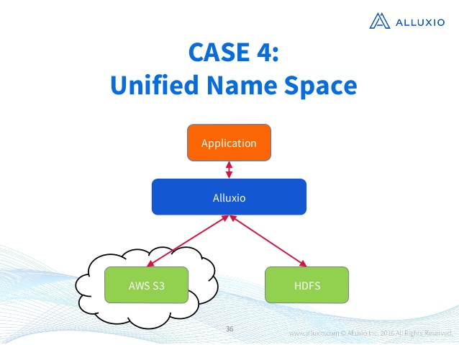
.

Slide 39
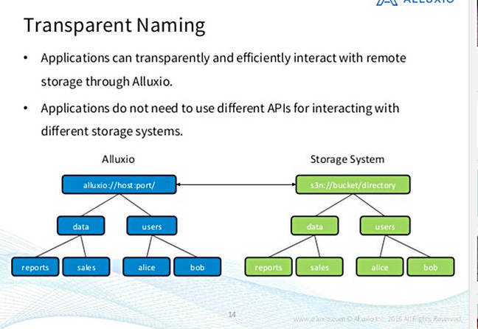

Slide 40
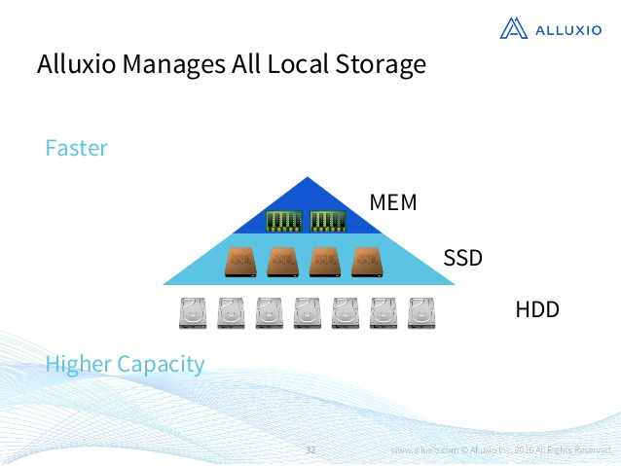
TIERED STORAGE

Slide 41
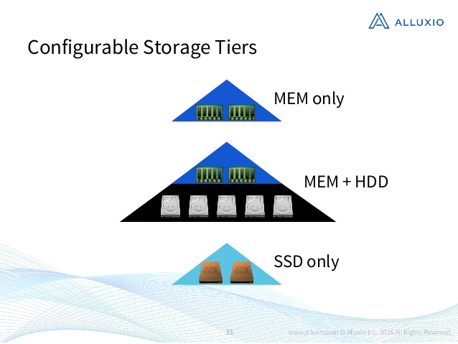

Slide 42
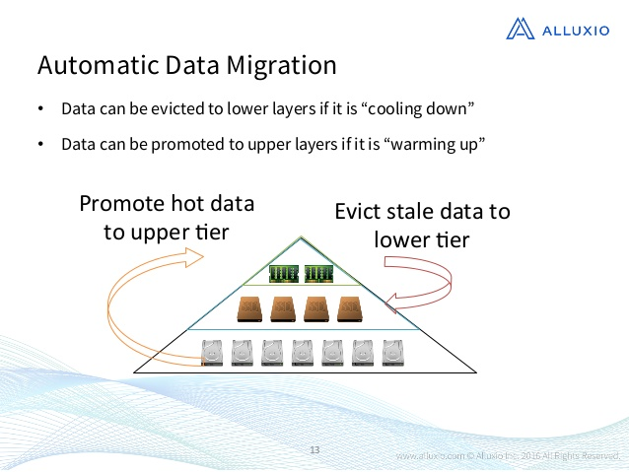

Slide 43
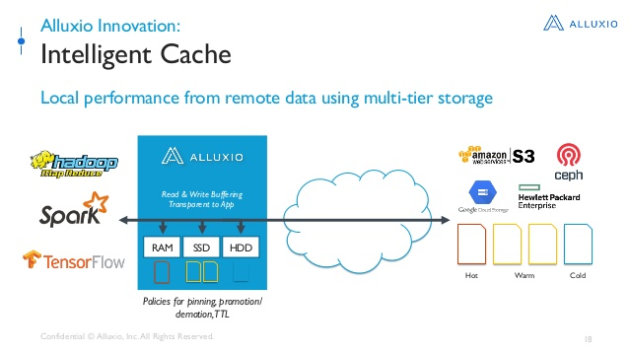

Slide 44
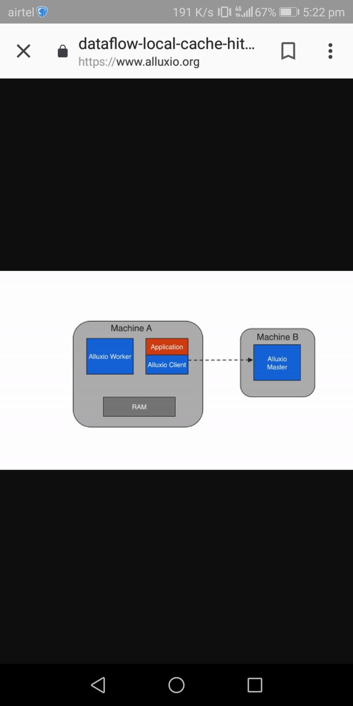


DATAFLOW IN ALLUXIO
Data Read
Local cache hit

Slide 45
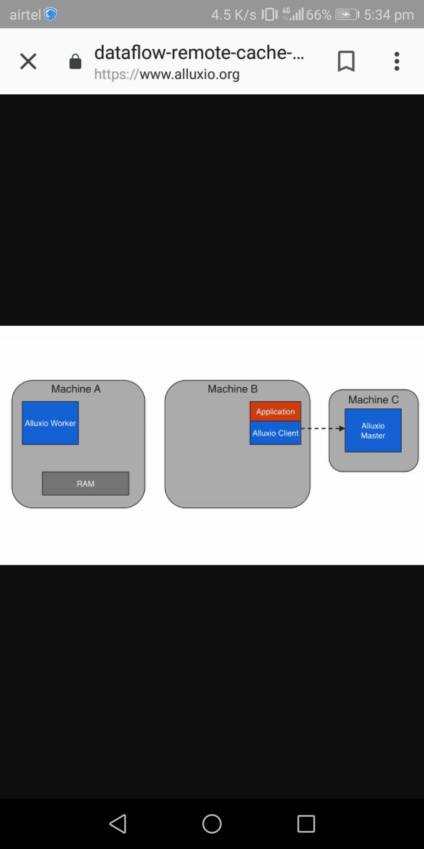

2)Remote cache hit

Slide 46



Slide 47
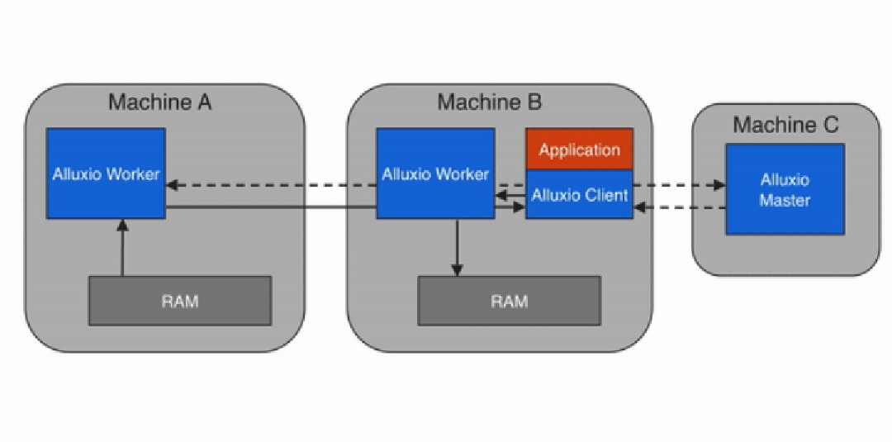

Slide 48
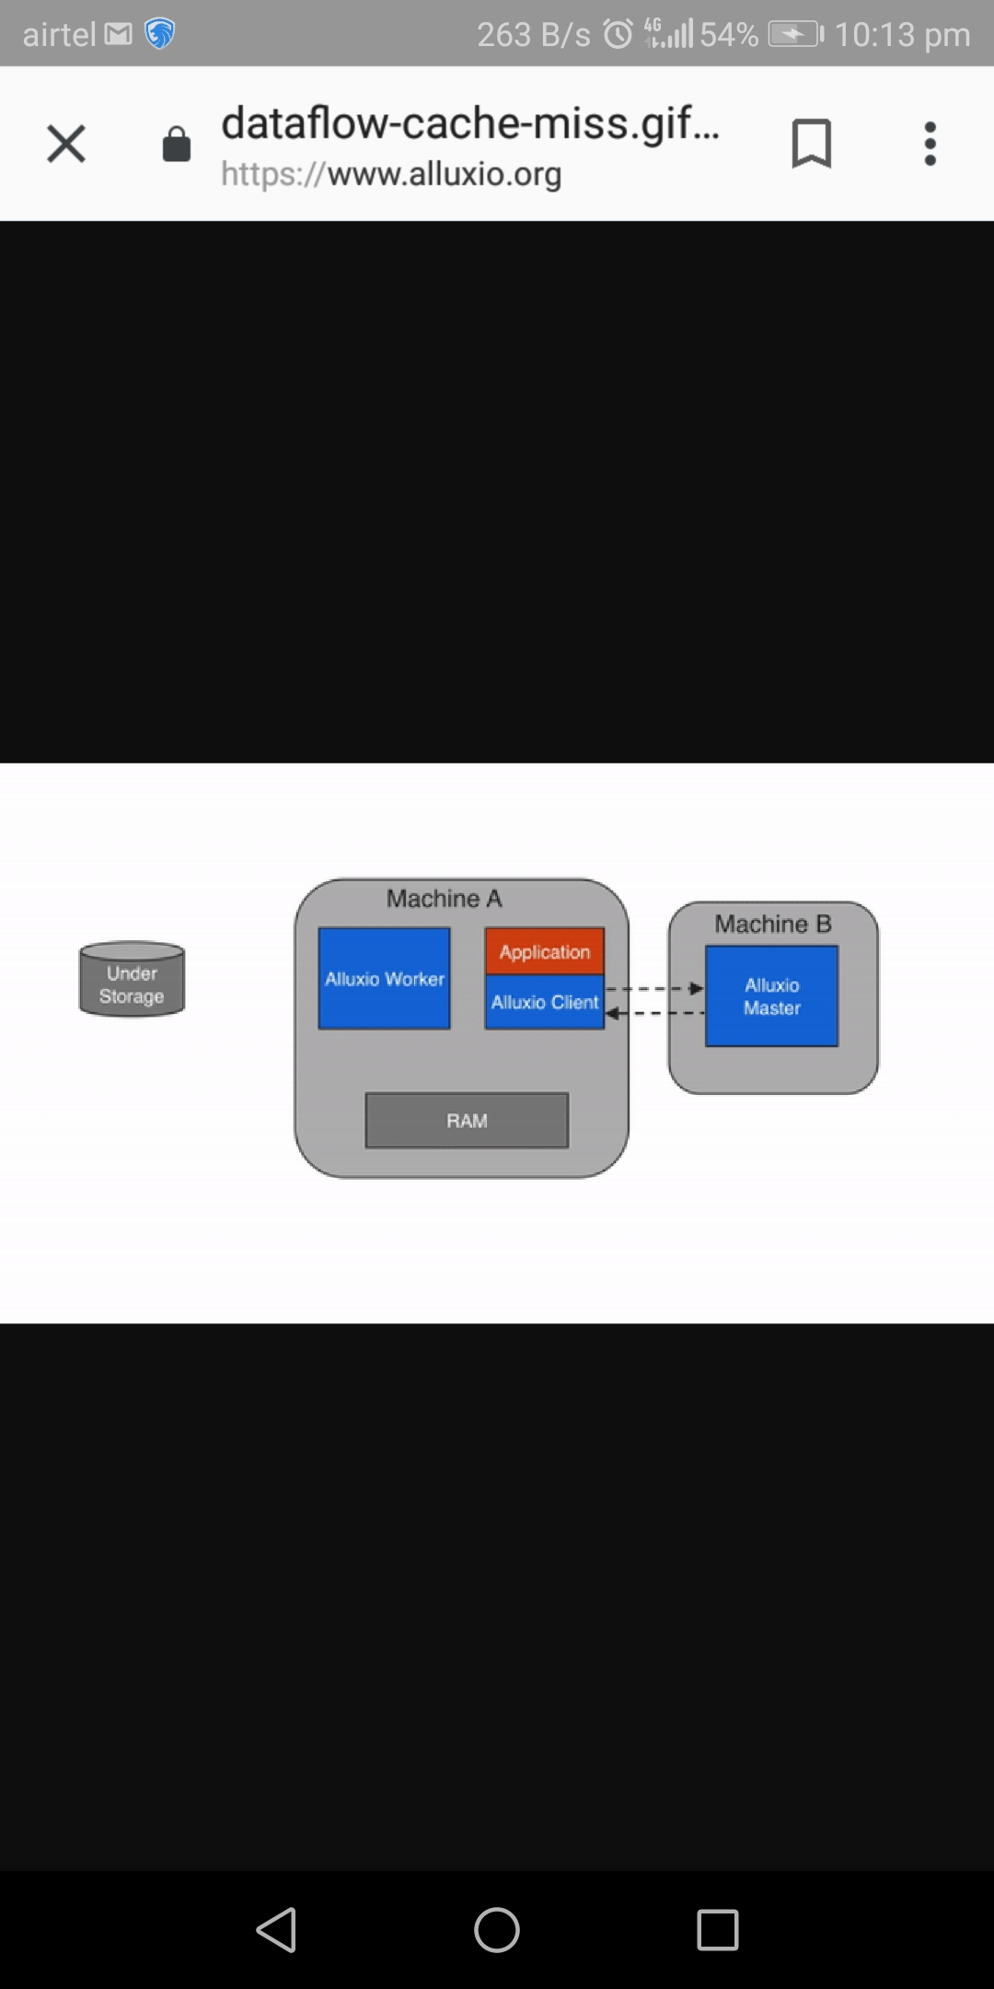
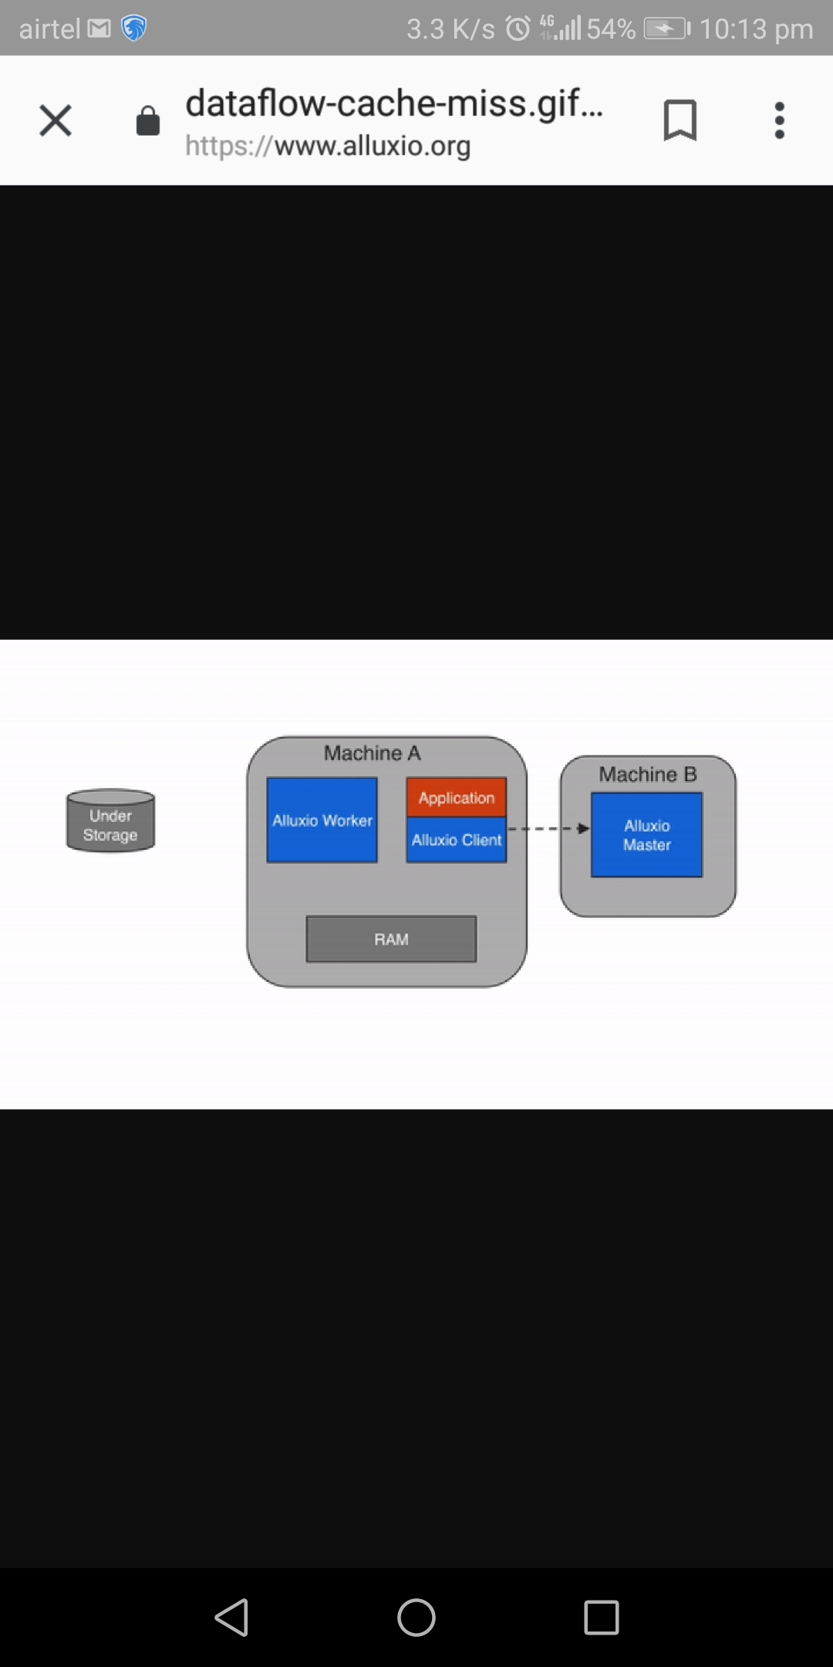

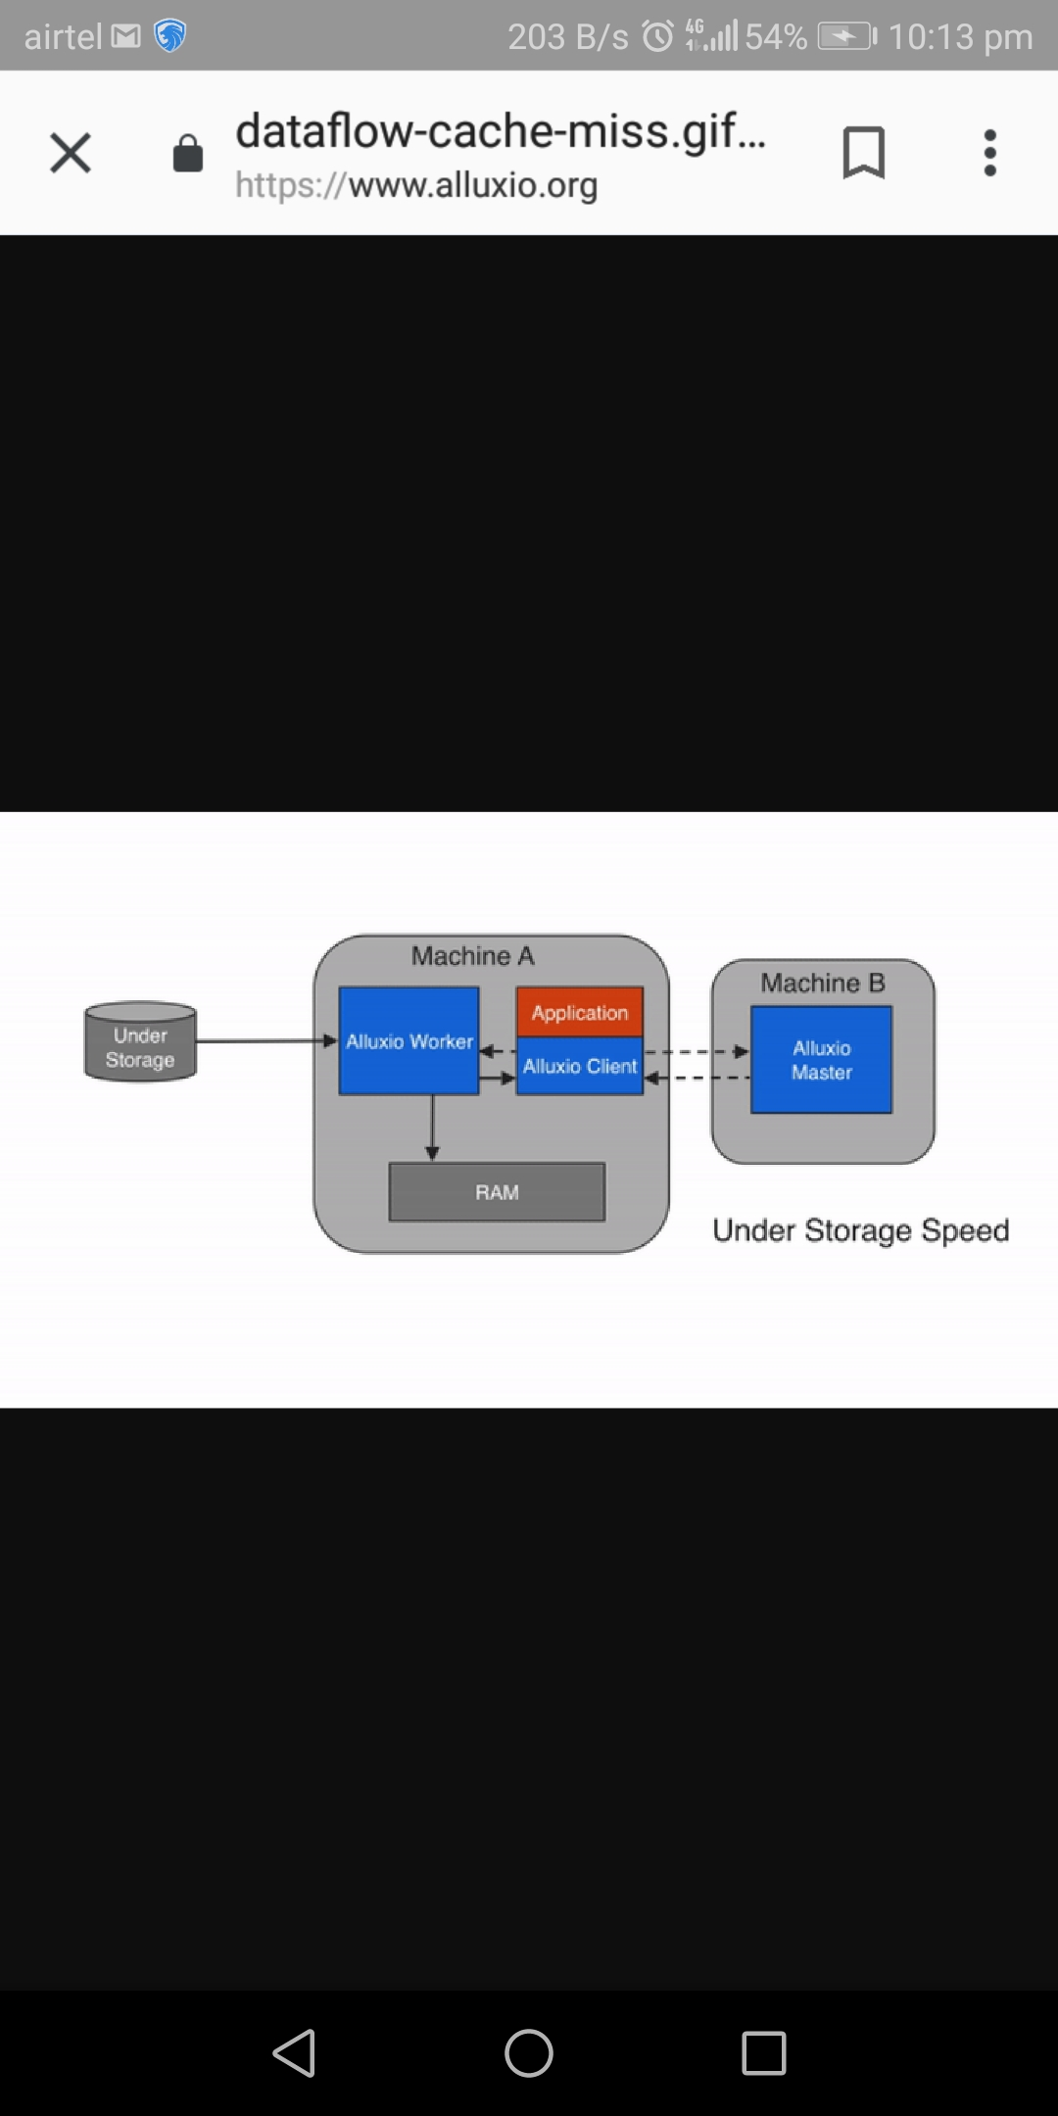
3) Cache miss

Slide 49
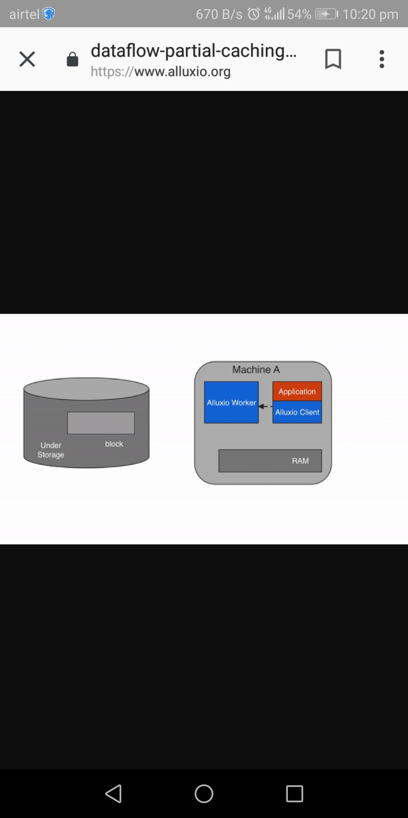
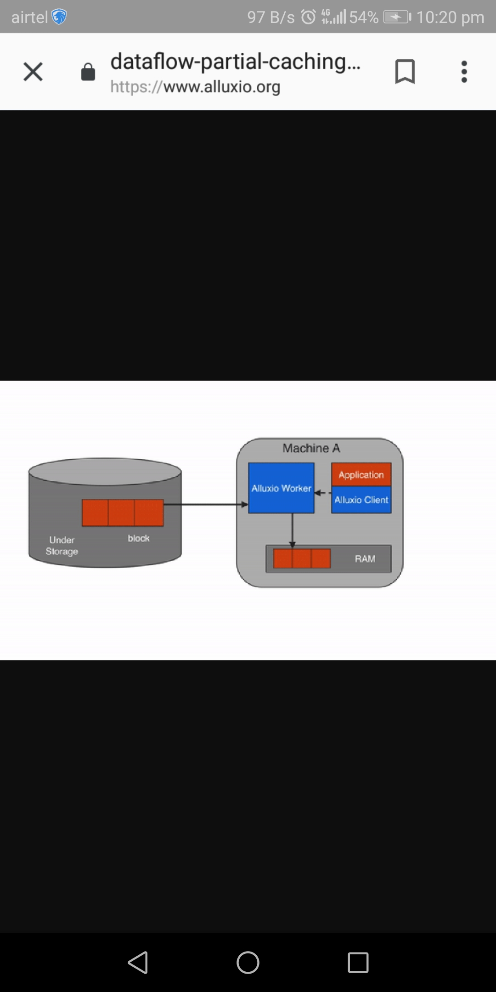
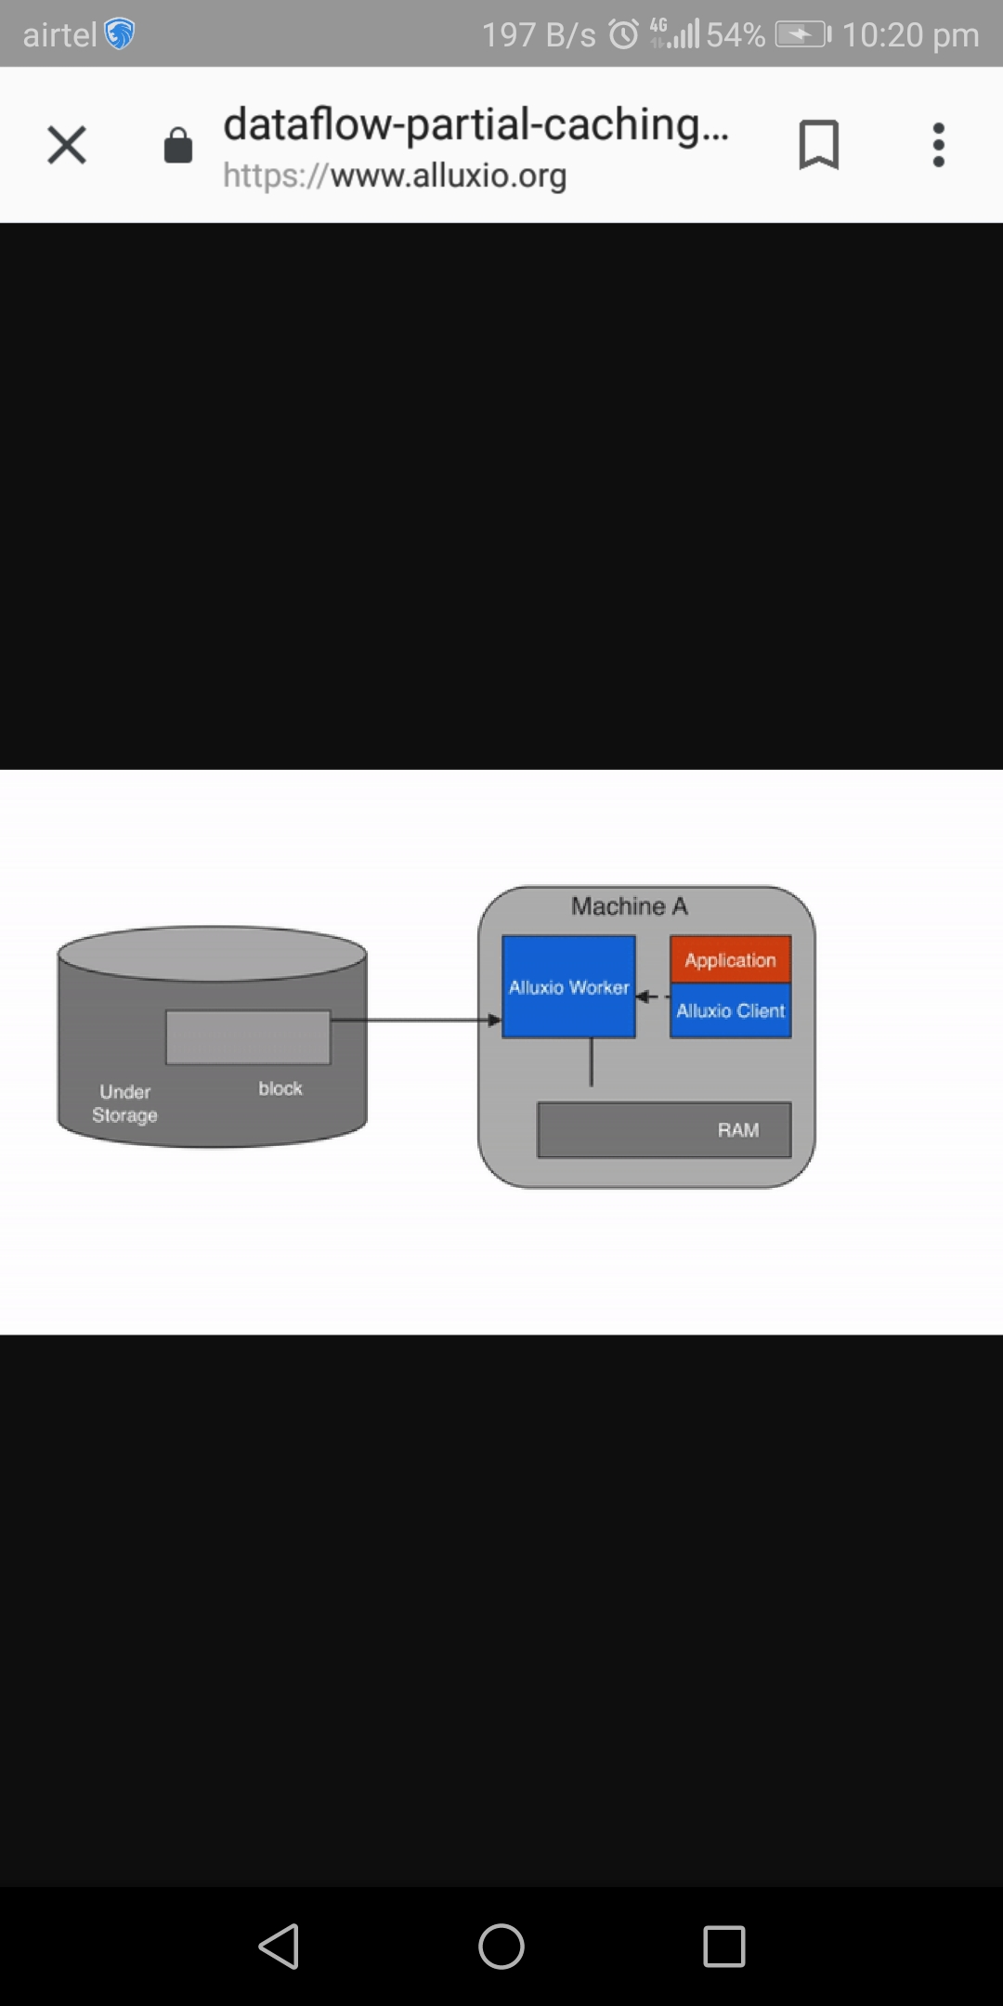

CACHING
partial caching-

Slide 50



No Caching
It's possible to turn off caching in Alluxio and have the client read directly from the under storage
DATA WRITE
MUST_CACHE (default)

Slide 51




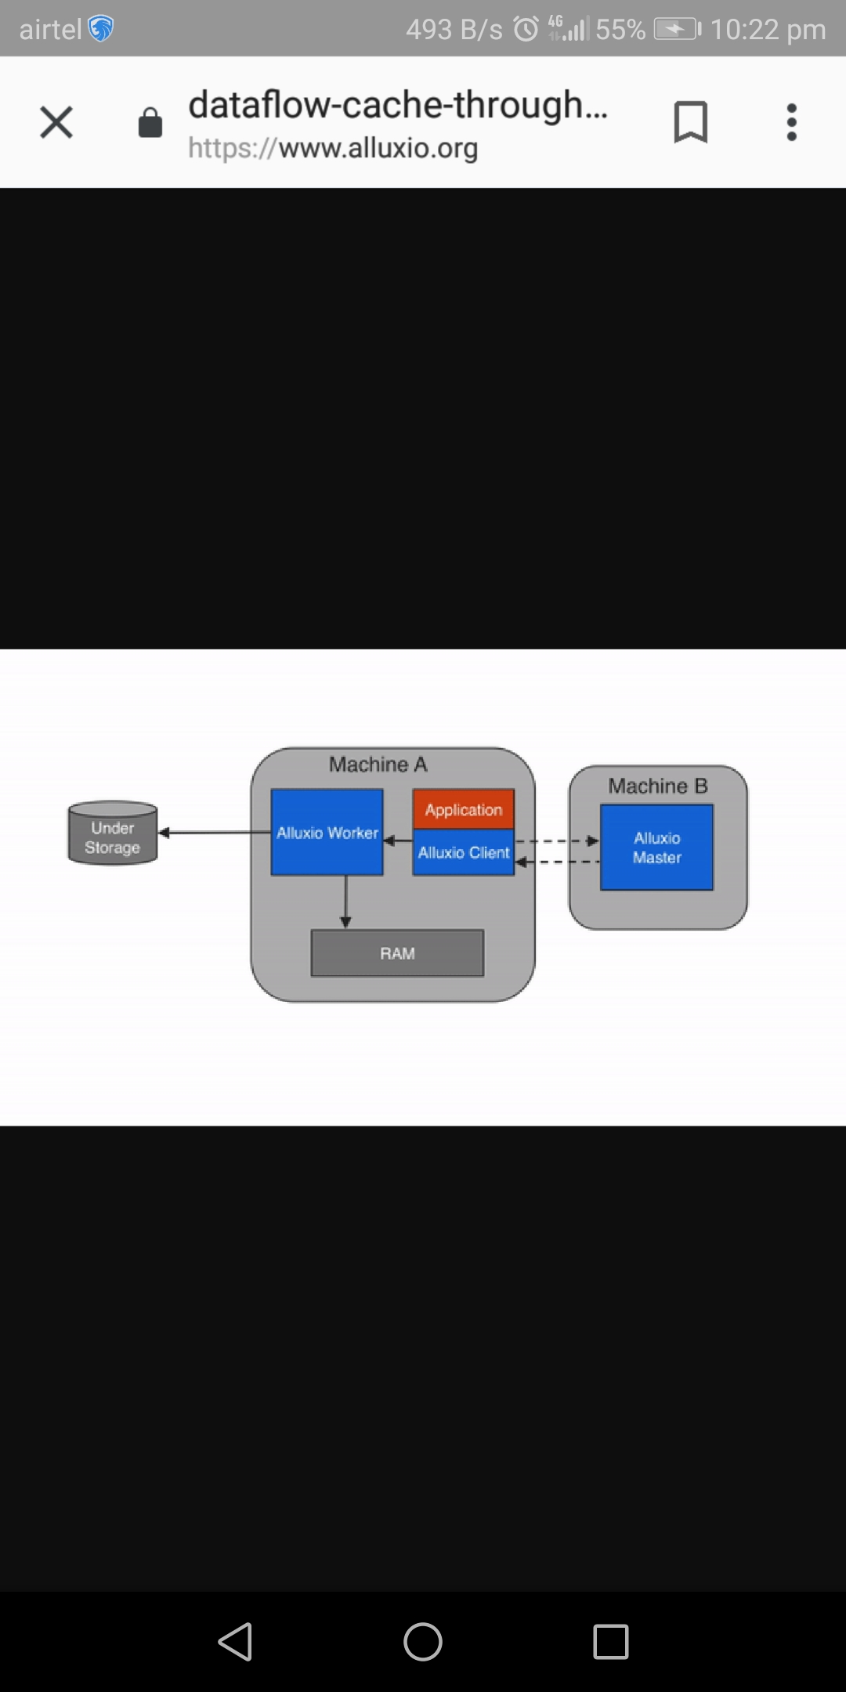
CACHE_THROUGH

Slide 52






ASYNC_THROUGH

Slide 53
INSTALLATION

Slide 54
DEMO CONTENT
Running a file from spark hdfs takes more time than running a file from alluxio and when it is hot then no time
Start-all.sh (file is stored in hdfs)
Spark-shell
Var rdd1 = textFile(“hdfs://localhost:9000/file”).count()

Slide 55
NOW FROM ALLUXIO
cd alluxio
nano file.txt
./bin/alluxio-start.sh local SudoMount
./bin/alluxio fs copyFromLocal file.txt /file1
Spark-shell
Var rdd1 = textFile(“alluxio://localhost:19998/file”).count()
// time is less (DEMO_1 COMPLETED)

Slide 56
DATA LOST TEST:::::
Ctrl-Z close spark shell
Now again start sparkshell
Compute with alluxio
DATA TIME IS NOT AS LONG AS IN CASE OF HDFS

Slide 57
Alluxio off data lost
Stop the alluxio and now if you
visit the alluxio
local host you will not be
able to find the file
in alluxio storage

Slide 58
THANK YOU :)
-Shashank Sahai
-Ripudaman Singh
-Anushka Chaudhary

